Slide 1

Momo Medical
Salah Abdulkader, Theo van den Berg, Roy Duivenvoorden, Nick Keereweer, Floris van Lingen, Jeanine Nagy

Slide 2
Inhoud
Data verkennen
Data schonen
Modellen
Vervolgstappen

Slide 3
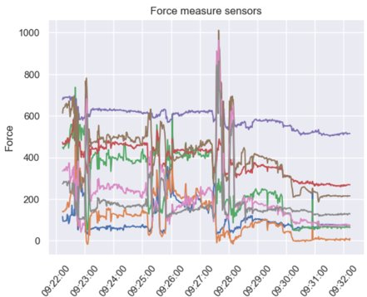
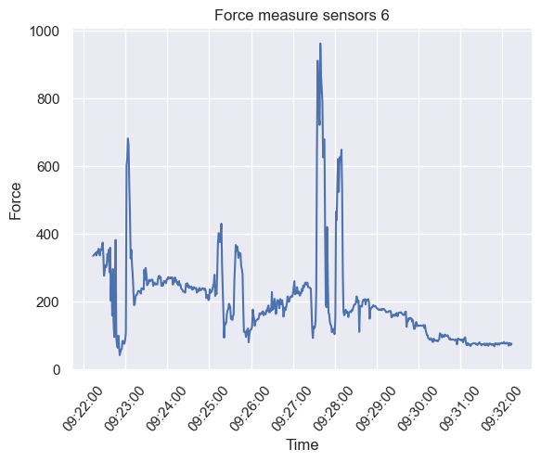
Data verkennen

Slide 4
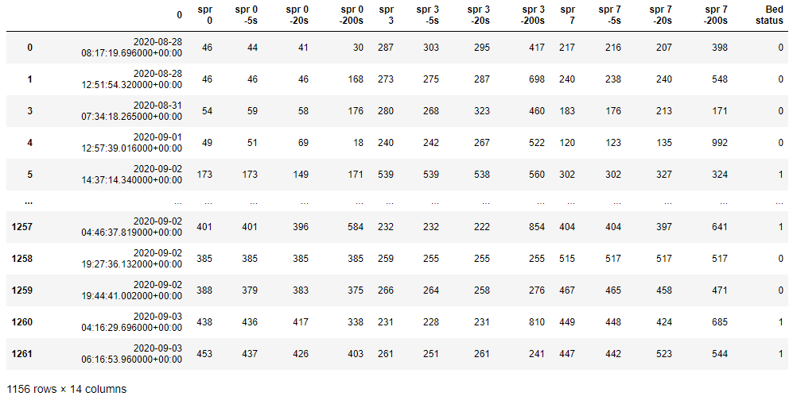
Data schonen
Data voor ons huidige model
Sensor data van 3 sensors
Bed Status

Slide 5
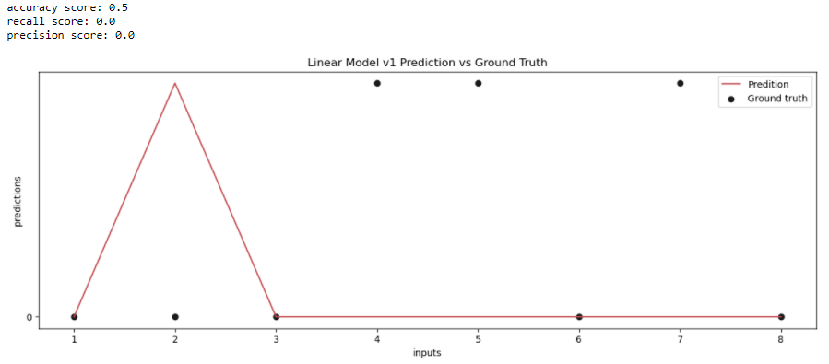
Model Linear SVM 1% training set

Slide 6
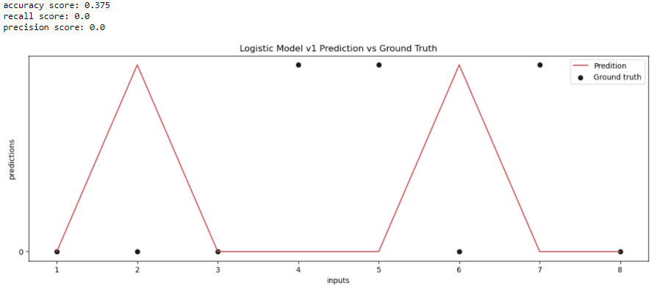
Model Logistic 1% training set

Slide 7
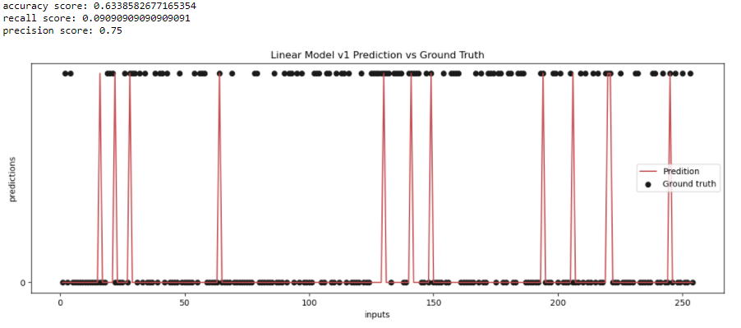
Model Linear SVM 30% training set 1 FSR sensor

Slide 8
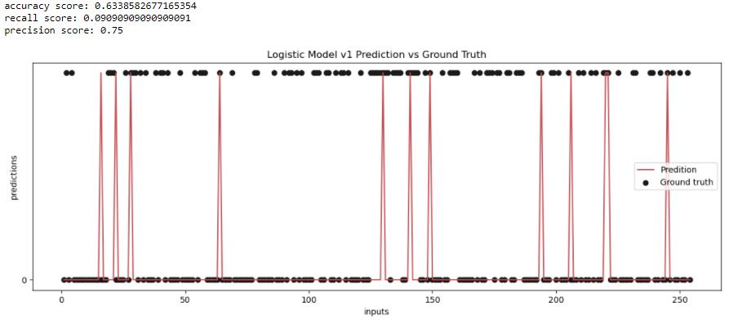
Model logistic 30% training set 1 FSR sensor

Slide 9
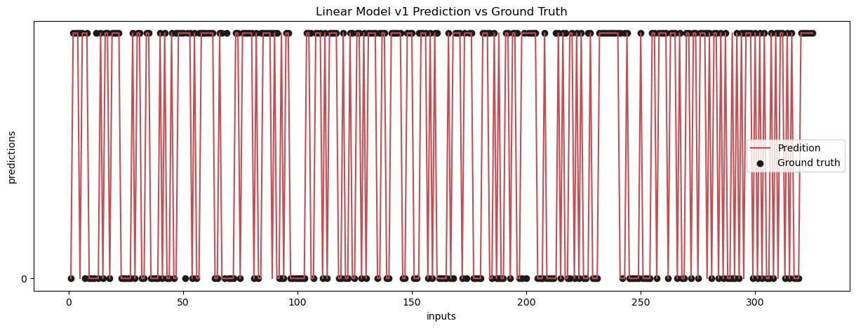
Model linear 70% training set + nieuwe features sp 0 and 7
accuracy score: 0.8953846153846153 recall score: 0.8953846153846153 precision score: 0.9418604651162791

Slide 10
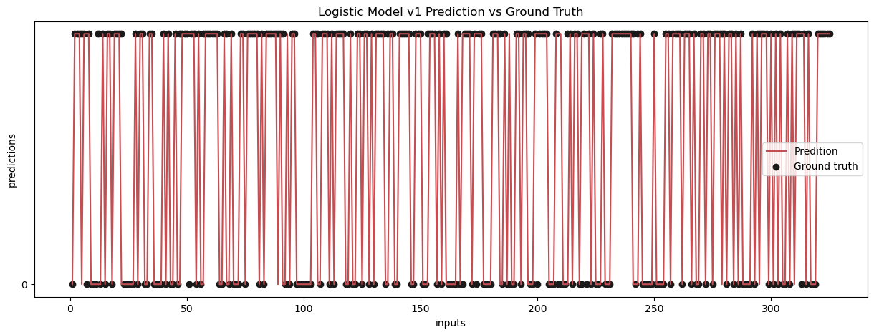
Model logistic 70% training set + nieuwe features sp 0 and 7
accuracy score: 0.8984615384615384 recall score: 0.8870967741935484 precision score: 0.9322033898305084

Slide 11
Vervolgstappen
Model uitbreiden
Meer features toevoegen
Hogere accuracy
Andere modellen uitproberen
Tijdseries
Deeplearning na meer colleges over dit onderwerp
Meer data gebruiken

Slide 12
Vragen

